Slide 1
ADAC Year 7 Annual Meeting
...Via Conference Call, 2-3 June 2021
ADAC Project Briefing
“Geofencing”
Dr. Shawn Butler
Assistant Term Professor
University of Alaska Anchorage

Slide 2
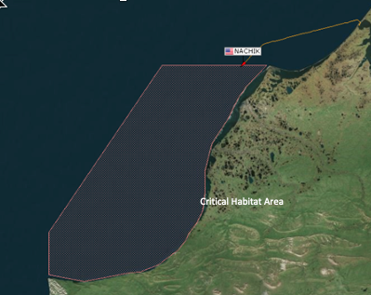
Project Geofencing: Geofencing for CG1View
ADAC Program Year 7 Annual Meeting 2-3 June 2021
Principal Investigator: Dr. Shawn Butler
Lead Institution: University of Alaska Anchorage
Supporting Team: Axiom Data Science
Student Participation: Rachelle Lewis
Project Champion: LT Evan Richter, USCG
Project Advocates: Anchorage Sector, CG District 17

Slide 3
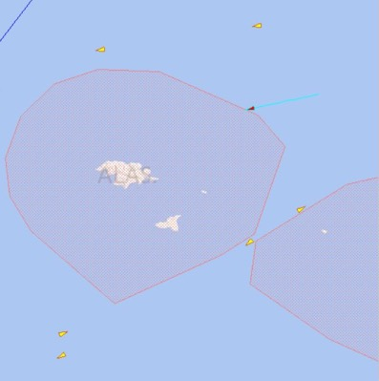
Project Geofencing: Description and Baseline
ADAC Program Year 7 Annual Meeting 2-3 June 2021
Create an application that allows the Coast Guard to create, manage, and visualize virtual geofences as an integrated component of the Coast Guard’s command and control system – CG OneView
Leverage lessons learned from AK Marine Exchange PACTRAC application

Slide 4
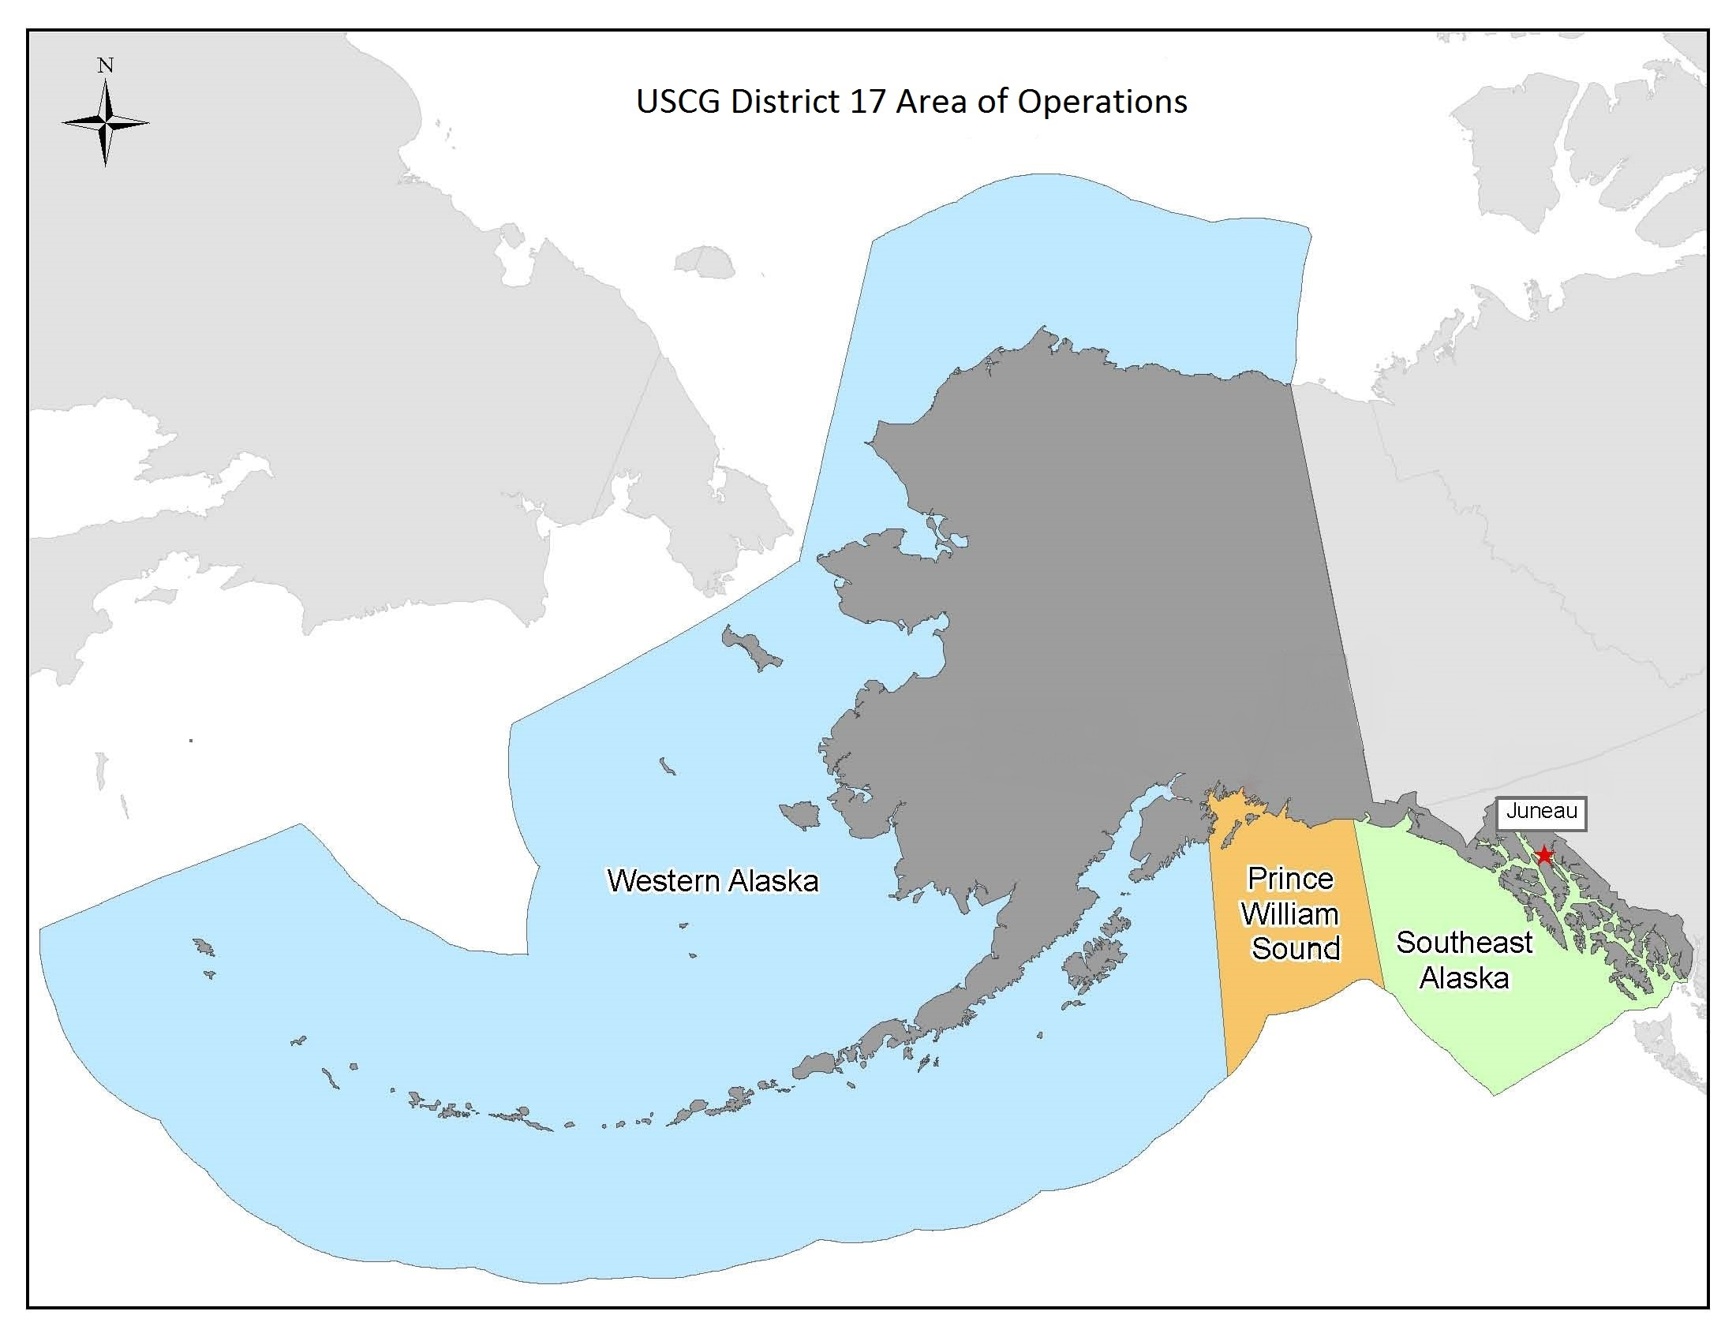
Project Geofencing: Relevance
ADAC Program Year 7 Annual Meeting 2-3 June 2021
Hundreds of ships travel the arctic waters each year
CG District 17 area of operations is over 3.8 million sq miles and more than 47,000 miles of shoreline.
Maritime traffic increased 250 percent between 2008 and 2015
Several sensitive marine habitat areas that need protected
Transiting vessels are prohibited from approaching too close to U.S. Shorelines
Vessels that lose power or cargo can pose a serious threat to the environment and other vessels
Monitoring hundreds of vessels can be overwhelming to watch operators
The Marine Exchange PacTracs system is separate from the CG Command and Control System – CG One View

Slide 5
Project Geofencing: Method
ADAC Program Year 7 Annual Meeting 2-3 June 2021
Baseline -
  AK Marine Exchange provides geofencing for their members
    Developed during the ADAC YR 5 and 6 geofencing project
    Initial requirements were developed collaboratively with Sector 17 and private entities.
    Although a significant leap in capability,
      Not integrated with CG One View
      Operates on a separate display screen
      Coast Guard has many more requirements
  CG OneView is designed to be documented and flexible
    Other developers should be able to easily add functionality
    Program office has never before been attempted to integrate a 3rd party application

Slide 6
Project Geofencing: Method - Current
ADAC Program Year 7 Annual Meeting 2-3 June 2021
Develop an application prototype that interfaces with CG OneView
  Adhere to USCG OneView documentation and architecture
  Develop USCG specific requirements
  Develop an application that allows USCG users to create, delete, and modify geofences, with more precision, and integrates into the CG One View architecture
  Alert USCG operators to vessels approaching or crossing a geofence
  Solicit feedback from Anchorage Sector on usability and functionality
  Minimize information overload

Slide 7
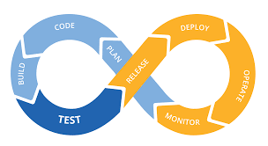
Project Geofencing: Method Future
ADAC Program Year 7 Annual Meeting 2-3 June 2021
Complete Prototype
  Develop a “Continuous Integration” process for continued application development
  Develop a working prototype to the USCG for integration with CG OneView.
    The US Coast Guard has more requirements in order to make it fully operational
    Current timeline to integrate into CG One View is approximately 1 week.

Slide 8
Geofence Architecture
CG One View
ADAC Geofence Application
Geofence Application
geofence messages
geofence store/retrieve
operational display
Geofence DB
USCG CG1V

Slide 9
Project Geofencing: Schedule and Metrics
ADAC Program Year 7 Annual Meeting 2-3 June 2021
Current year research schedule and milestones:
  Initial Integration with CG OneView
  Implemented multi-layer geofences
  Validated CG OneView Documentation and Interfaces
  Successful integration with CG OneView
Current year metrics:
  Completed initial user application to create and manage geofences
  Evaluate with USCG Anchorage Sector

Slide 10
Geofencing: Planned Research Outcomes
ADAC Program Year 7 Annual Meeting 2-3 June 2021
A prototype geofencing application that can be quickly integrated and distrusted with CG One View
Code, requirements, and documentation transition to Coast Guard

Slide 11
Geofencing: Key Accomplishments
ADAC Program Year 7 Annual Meeting 2-3 June 2021
Requirements, Requirements, and Requirements!
Integrated into the CG OneView architecture
Opened the pathway for 3rd party developers to add capability to CG OneView

Slide 12
Project Geofencing: Transition Plans
ADAC Program Year 7 Annual Meeting 2-3 June 2021
Develop a continuous integration process with CG One View developers so they can integrate with CG One View
Deliver the final prototype to CG OneView developers for integration testing and production

Slide 15
Ready for questions
ADAC Program Year 7 Annual Meeting 2-3 June 2021
Feedback…
What are we missing?
What can we improve?
Who should we connect with to improve odds of research success?
(Insert graphic associated with the research)
Notes:
Thank you for the gift of your time and attention.

